Slide 1



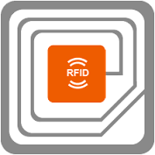





Delivering Product Transparency and Consumer Experience in the New Economy
Dec 2022
Present By Grace Hui, Kenny Yeung
Brand Protection
Anti-Counterfeit and Track-n-Trace
Solution
Cloud

Slide 2
01
Company Introduction
02
AccessReal
03
AccessReal Case Studies
04
Q&A

Slide 3
COMPANY INTRODUCTION

Slide 4


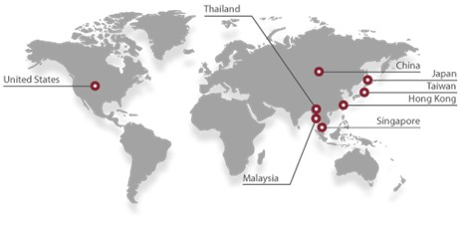
VISION STATEMENT
Identity, Credential and Access Management Solution - The Force of Identity Plus
i-Sprint, established in Year 2000, is the subsidiary of the ASL Group, Hong Kong Listed company (Stock code: 0771) as a world-class Solution Provider by offering the Identity, Credential and Access Management Solution, enables individuals, organizations and societies to build trust and identity assurance for powering huge productivity gain through digital identity and identity of things.
Sales Regions
Staff Strength
R&D Centers
International Markets:
Singapore (HQ), Japan, Malaysia, Thailand, Hong Kong, USA, Taiwan
China Market:
Beijing (HQ), Shanghai, GuangZhou, ShenZhen, Chengdu, Zhuhai
Singapore and China (Beijing, Zhuhai)
~160+ with over 120 Engineers and Developers

Slide 5

















Our Product Suites AccessMatrix™/ AccessReal™ / YESsafe On-Premises and Cloud Delivery
Mobile Security
Protection of Data, User Identity, Apps on Mobile Devices and providing a PINless login experience for multi-channels
Product Identity
Brand Protection, Counterfeit Detection, Track-n-Trace & Data Analytics
Suite of Digital Identity Management Solution
Universal
Authentication
Server
Universal
Sign-On
On-Premises and Private/ Public Cloud
Universal
Access
Management
Universal
Credential
Manager
Notes:
Page 5
Lets have a quick recap on our product lines again
@@@@@
Our core platform is AccessMatrix with 5 modules which covers the entire Identity and Access Management Life Cycle requirements.
@@@@@
Our AccessReal, which will focus our discussion on, is built on this core platform with the focus on product identity
@@@@@ x 3
we allow our customer to select our solutions on premises， which is preferred by 90% plus of our AccessMatrix customer， while most of our AccessReal customers will prefer our cloud offerings.
@@@@@ x 2
Last but not least, the YESsafe mobile security solution is a very important component of our products

Slide 6












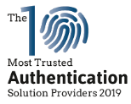














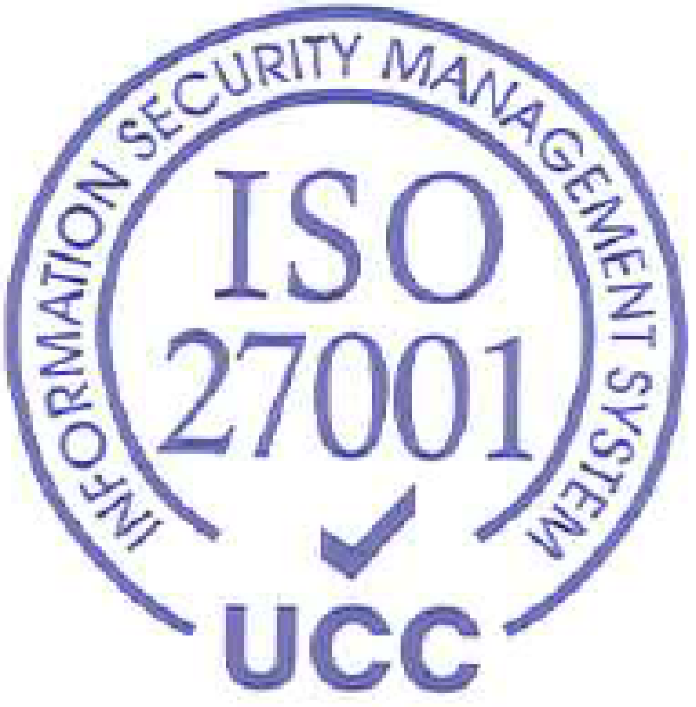


i-Sprint Innovations World Leading IAM Solution Provider
Our Solutions
Recognition
Competitive Advantages
Digital Identity
Recognized as a leading IAM solution provider in Asia
By various reputable organizations
Identity Protection
Asia Pacific Cybersecurity Companies
China Cybersecurity Companies
Digital Identity & Security Management Solution
Mobile Protection
Proven Technology
> 200 enterprise customers (bank grade)
> 150+ millions enterprise Users
Mobile Protection
Data Protection
Complete Suite of highly secured IDoT platform
Protecting > USD $20 Trillion of total asset value
Product Identity
Complete suite of IAM/ IDM
on-premises & cloud offerings
To prevent frauds in cloud, mobile &
enterprise environment
Identity of Things (IDoT) Solutions
Product Identity
Track & trace /Big Data Counterfeit Detection
100% owned IPs
with patented technology
Notes:
this is one chart to quickly summarize i-Sprint - our solution , Digital identity/ product identity, we will discuss more about this later . We are well recognized by reputable organizations as the top IAM solution provider ; of course , orders form by customer prove we are one of the best solutions. We are proud to develop and provide our patented solutions to serve enterprise customers worldwide .

Slide 7
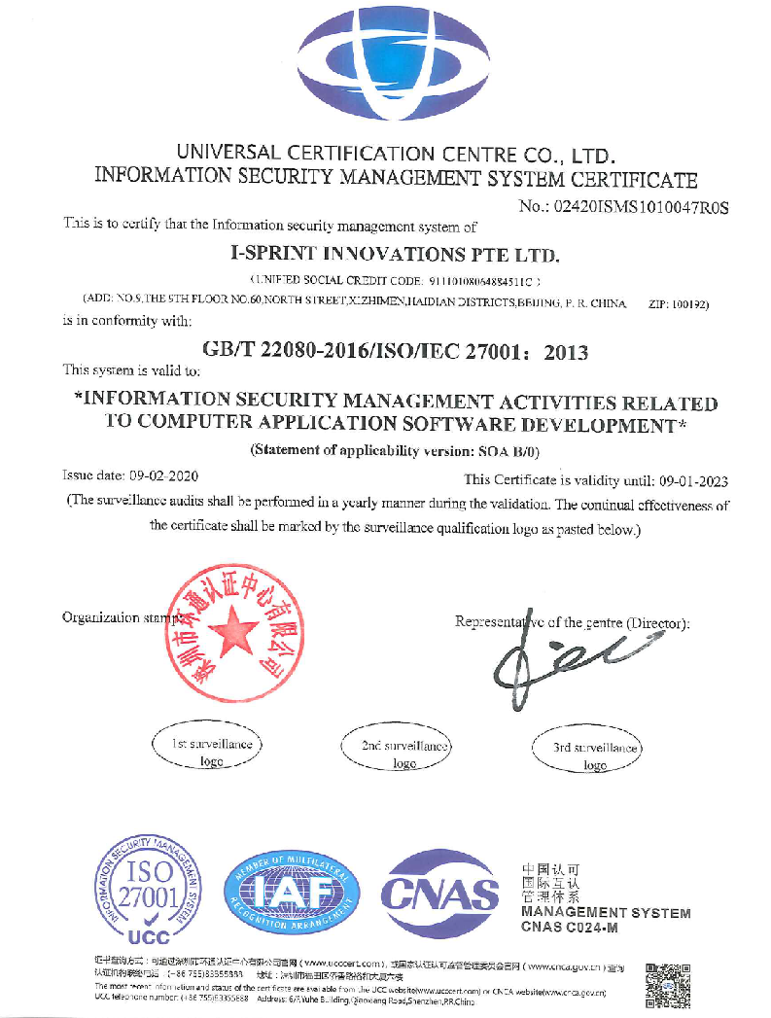
ISO 27001 Certified Cloud Operations
ISO 27001 is a globally recognized benchmark for the effective management of information assets.
The ISO 27001 certification indicates that our company has identified risks, assessed the impact and conducted systematic controls to provide our customers with reliable and secure cloud services.
Notes:
Our cloud operations has received the ISO 27001 Security Operations Certification.

Slide 8






































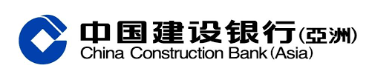
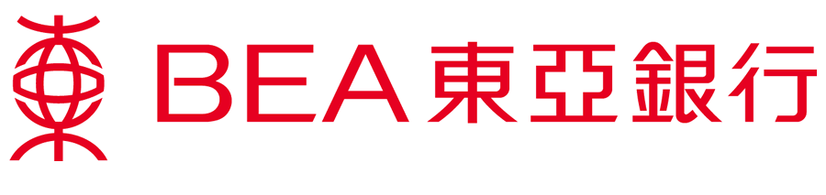





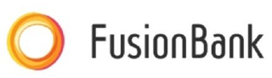








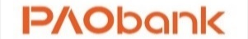
















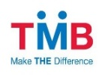























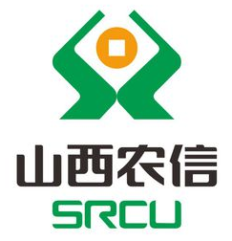

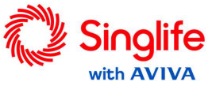







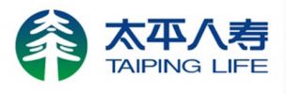








i-Sprint, a World-class Cyber Security Company Reference Clients in Financial Service (Partial)
Notes:
Key Messages:
Here is a list of our customers from the Financial Services Industries which includes Banks such as citibank for their global private banking for more 14 years, Insurance Companies, and Stock brokerage firms.

Slide 9












































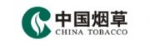
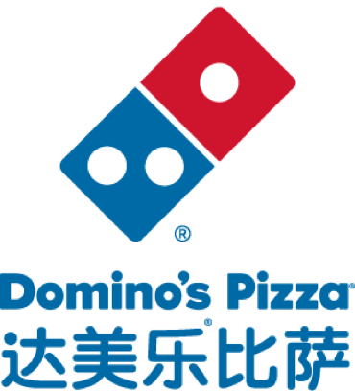
















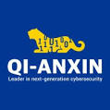





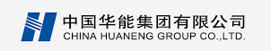

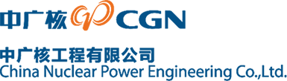









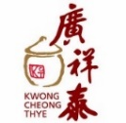



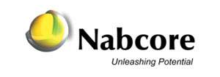
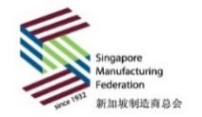
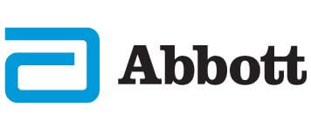
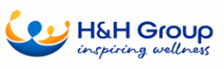

i-Sprint, a World-class Cyber Security Company Reference Clients in Non Financial Service (Partial)
Notes:
Key Messages:
Here is a list of our customers from the Non Financial Services Industries which include Government agencies such as strong regulatory authority endorsement from Monetary Authority of Singapore and Hong Kong Monetary Authority, airlines, universities and manufacturing industries.
We are growing these sectors to expand our market with our new product offerings such as YESsafe Mobile Suite and AccessReal Brand Protection and Product Authentication Suite

Slide 10
Access Real
Brand Protection & Anti-Counterfeit Solution

Slide 11
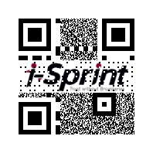
AR Code

Slide 12

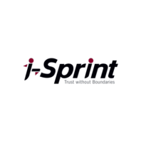


Brand Protection Solution A Unique Bank-Grade Clone-Proof QR Code (AR Code)
Encrypted QR code with Digital Watermark
What is AR code?
An encrypted QR Code, embedded with digital watermark which is our Patented technology make it become uniquity, enable the product authentication function.
On top of the product authentication checking, we as well support the general features of a standard QR code (ie - product info, bind to the different specific landing URL for brand’s extensive purposes by different parties)
Leveraging the blockchain & AI technology, it also is a platform / an equipment for…
REAL TIME Track-and-Trace visibility
BIG DATA COLLECTION: counterfeits scan detection, CRM with mass data analysis
Easy adoption on the materials, printing requirement (range from 400 - 1200 dpi)
Product ID and/or other information stored in QR Code
Sticker
Product or Company logo
SCAN ME!
Digital Watermark
For Anti-Counterfeit

Slide 13
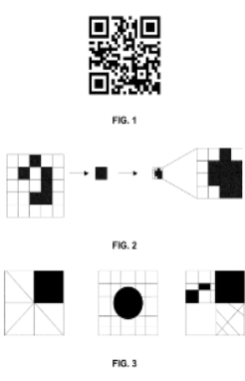
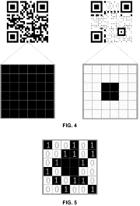
Patents Granted
US20210042486A1 Two-dimensional barcode generating method, verification method, server and two-dimensional barcode [GRANTED]
Here showed how embedding watermark into QR Code and how to perform authentication
Access Real Code, it's built on top of the standard QR Code with added unique patented “Anti-Counterfeiting Technology”, which can verify the authenticity of the product.
This technology has been granted the patents by:
State Intellectual Property Office of China https://patents.google.com/patent/CN110009080A/zh
United States Patent and Trademark Office (USPTO) https://patents.google.com/patent/US11288475B2/en
Japan Patent Office https://patents.google.com/patent/JP2021529336A/ja

Slide 14

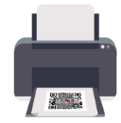

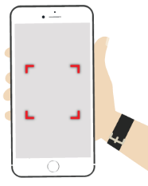




Secure QR Code with Digital Watermark for Product Identity Authentication Amount of Watermark & Other Information presence in the AR Code will determine its authenticity
Direct Printing
Photocopy
DIGITAL COPY
100%
Authenticity Indicator
ORIGINAL PRINT
85-98%
Watermark and Quality
PHOTO COPY
<85%
Watermark and Quality
Genuine
Fake
*The differences of the scanning grade is subjected to change upon several differentiative factors, as such materials, printers, printing models.

Slide 15






AccessReal Technologies
Secured identification codes
(AR Code, AR Mark)
Anti-counterfeiting Technologies
Technology Support
Product Provenance, Ownership Registry, Delivery Management, NFT Integration/Transaction and Bill of Material Tracking
Web Shell Scan
Intrusion Detection
Artificial Intelligence (AI) to enhance the counterfeit detection/ data analytics
AI
NFT
User Interface
(Mobile, Web & WeChat)
Notes:
Under Anti-counterfeiting Technologies, we have created AR code, a clone proof QR code and AR Mark to strengthen the security level of the identification codes used on the product packaging.
Incorporated Artificial Intelligence (AI) to enhance the counterfeit detection/ data analytics
Used blockchain for Product Provenance, Ownership Registry, Delivery Management and Bill of Material Tracking
The solution can be used by consumers through mobile app, web app and WeChat

Slide 16



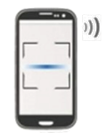





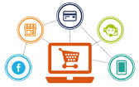
Brand Protection Solution Anti-counterfeiting , Track and Trace and Consumer Marketing
Brand Protection/ Ease of Product Authenticity Check
Empower consumer to self-check product authenticity
Aid supply chain partners to identify product origin from the factory
Cross Markets Track & Trace
Product movement status in the supply chain Product Diversion
Anti-
counterfeiting
Track &
Trace
Unique Identity on Each Product
Data
Analytics
Product
Recall
Business Insight
Consumer buying preference (e.g. when, where)
Product scan statistic (e.g. scan to enquire, scan to check authenticity)
Value-added Consumer Service
Push message via mobile app (e.g. loyalty program, new product launch, product recommendation)
Special promotion for consumers who scan and check authenticity, follow up on maintenance
Direct Customer Engagement
Notes:
AccessReal provides a unique digital identity to every product. Products with digital identities are like smart products that can be linked to online systems and track the product life cycle in the supply chain. It can be used for:
To fight counterfeit
Domestic and cross-border logistics tracking
Data collection
Customer interaction and marketing
The unique digital identity is tagged on a product using identification codes like barcode, QR code, NFC or RFID . i-Sprint emphasizes the solution's security. We have incorporated several security features to ensure our solution cannot be compromised from the front or back end.

Slide 17
ACCESSREAL CASE SHARING

Slide 18

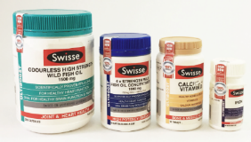

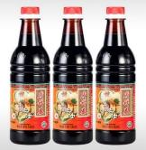
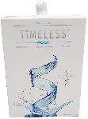

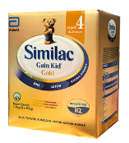




AccessReal – Successful Cases in Various Sectors
Wine
Health Supplement
F&B
Life Style
Anti-counterfeit
Consumer Marketing
Anti-counterfeit
Grey Market
Consumer Marketing
Anti-counterfeit
Consumer Marketing
Anti-counterfeit (especially, China)
Consumer Marketing
Manufacturing
Pharmaceutical
Tobacco
Associations
Private label under SMF SMART – federation as the platform provider
Companies in Singapore can subscribe under SMF to use the system and SMART App for authentication
Anti-counterfeit
Extra content
Consumer Marketing
Anti-counterfeit
Track & Trace
Anti-counterfeit
Consumer Marketing
Notes:
Our customers for the past two years have been from wine industry, milk powder manufacturer , pharmaceutical . We are proud to be selected by Singapore Manufacturing Federation as the only platform provider for its members.
I will like share our Bayer cases as how they deploy our technology
小教大道 / Swisses / 廣祥泰 / Timeless (from 新加玻) (Skin Mask) / Abbott / Bayer / Tobacco (from 越南) / 新加玻建造商總會
@

Slide 19



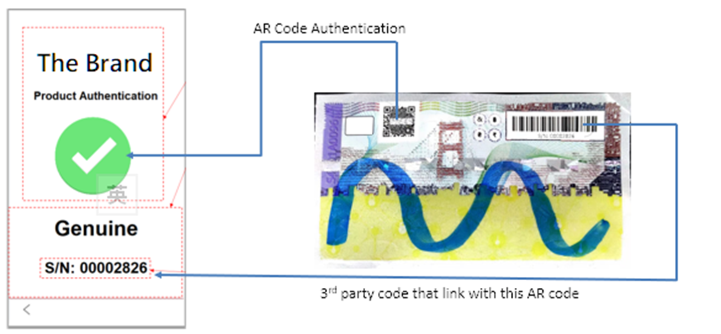
AccessReal – New case sharing
The Global technology company, is looking for an anti-counterfeit solutions to help minimize the grey market & replicated products release to the market.
Pain point: Counterfeits, Grey market leaks.
Current Flow
Hologram print effect Barcode Serialisation
New Flow with AR solution
Hologram print effect Barcode Serialisation AR solution, bind with serialisation
Advantage:
Our solution helps the enterprise to trace the leakage whereabout
Flexible to link up company’s existing barcode serialisation with our solution, directly link to Brand’s website for authentication checking; lowering down the change impact to the enterprise.

Slide 20




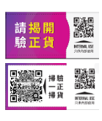
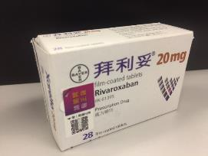
Bayer Pharmaceutical
Bayer is a life science company with more than 150-year history and core competencies in the areas of healthcare and nutrition. Placing great focus on research and development activities on preventing, alleviating, and treating
diseases.
Pain point : Grey Market challenges
Lack of Control & Visibility on channel management
Spotted parts of the clinic products leaks to drugs stores that bring impact to pharmacy channels.
Solution: Dual Layer QR + AR code
Resolve the Grey market matters:- Trace the leakages through the supply chains
Product authentication checking
Extensive features: Customer loyalty reward program, CRM analysis with big data collection
Exposed Layer
QR Code
Hidden Layer
AR Code
Outcome: Our solution helped Bayer to identify the leakage whereabout and took the necessary actions.

Slide 21
Benefits with Access Real solutions
Brand Owner | Consumer
Brand Reputation Protected Production Authentication Protected Product info digitalised | Brand Assurance
 | Quality Assurance
 | Retention willingness
Direct engagement (Interaction) facilitate additional interaction - Loyalty & reward programs, membership registration, survey, etc.
User-friendly on code scanning adopted by mobile, web and wechat scan
Go Green, Eco-friendly & Sustainable less printer & material constraint | Uplift Satisfaction with green strategy
Cost Effective
Big Data Collection Scan activities, market trend with consumer buying behaviors

Slide 22
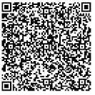
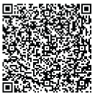
Questions
CONTACT
GRACE HUI |  | JENNY HO
SENIOR SALES DIRECTOR |  | SALES MANAGER
+852-9108 1836 |  | +852-9164 9214
grace.hui@i-sprint.com |  | jenny.ho@i-sprint.com

Slide 24
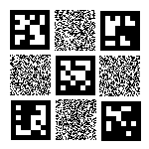

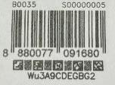
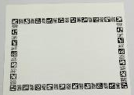
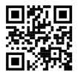

Our Innovation and Technology Break Through
A Unique Bank-Grade Clone-Proof AR Mark
AR Mark
Non QR-Code based Anti-Counterfeit Technology for combining with other tagging technology such as barcode/datamatrix/QR/etc
AR Mark can carry information
Features and Benefits of AR Marks
Serialization and anti-counterfeit of barcodes
Serialization and anti-counterfeit of graphics such as logo
Anti-counterfeit apply to existing QR Codes.
Standalone
Anti-Counterfeit mark
(6mm x 6mm)
Standalone
Anti-Counterfeit strip
(2mm x 16mm)
Sample
Use Cases of AR Mark
Convert any QR Code into
anti-counterfeit
labels with serial number
(e.g. Any QR Code)
Adds serial number and
anti-counterfeit capability
to barcode
(e.g. GS1 UPC Code)
Adds serial number and
anti-counterfeit features to DataMatrix Code (e.g. Pharmaceutical Products)
Combine 6 AR Mark Strips into a box to protect graphics within the box area.
(e.g.. Company logo, etc)
Notes:
AR Mark is developed to provides flexibility to companies that need to use existing standard codes such as barcode, QR code, or DataMatrix code but have an anti-counterfeiting function. Besides acting as an anti-counterfeiting feature, the mark can carry information.

Slide 25
APPENDIX

Slide 26
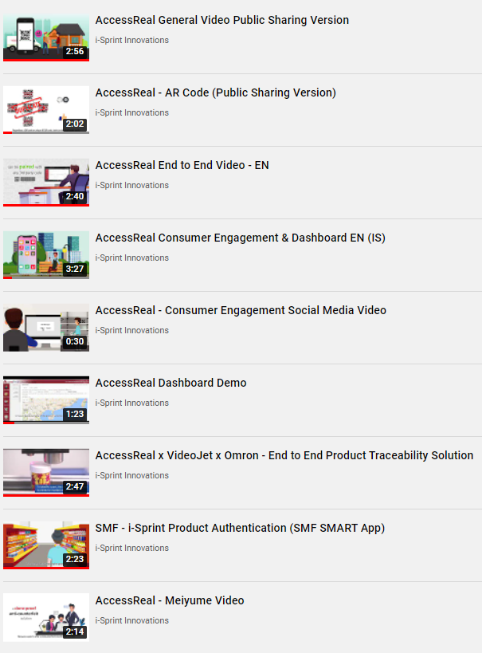
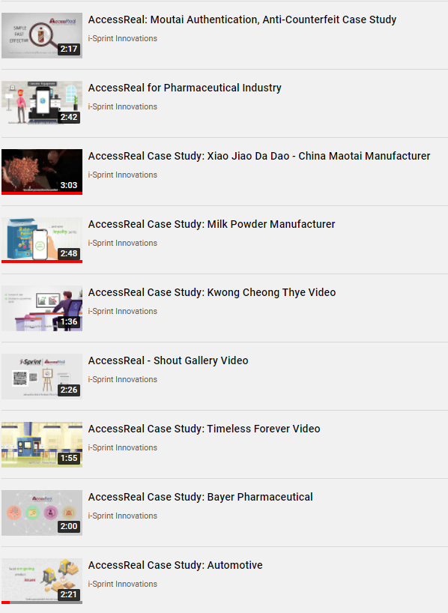
Youtube Videos - Additional Information
https://youtu.be/4kSgVX3SQM4
https://youtu.be/MSuf2UOiobg
https://youtu.be/pMuH6lJQVuE
https://youtu.be/6JatzHokFNM
https://youtu.be/G_KoiVDijH8
https://youtu.be/bgdPo6aP5eg
https://youtu.be/etjgLxXa-1o
https://youtu.be/DznMK7iMwks
https://youtu.be/J6hFIhAiaqs
https://youtu.be/O8f0ggo6-KE
https://youtu.be/pv1tYvBadME
https://youtu.be/zUPM5eKR8u0
https://youtu.be/wqYCs946V80
https://youtu.be/-dk4TlH2_R8
https://youtu.be/7mRFh9mIk58
https://youtu.be/e32JJiLLr_Q
https://youtu.be/y6fH-Xp8Tsg
https://youtu.be/nDL0zt1b7lQ

